Slide 1
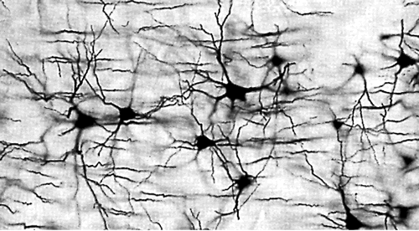
A PROCEDURE FOR Thinking
COMP 4230
David J Stucki
Fall 2024

Slide 2
ALERTS
Thoughts on John Searle?
Thoughts on Larson Chapter 2?
Read Chapters 3 & 4 of Larson
Assignment #2, due Friday, 9/13

Slide 3






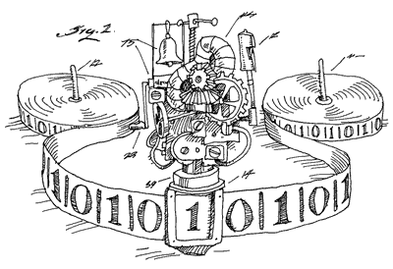
MODELS OF COMPUTATION
“Once a problem is described using an appropriate
representation, the problem is almost solved.”
–Patrick Winston, 1993
1930s: An exciting time…
  Alan Turing Stephen Kleene Kurt Gödel
  Alonzo Church Emil Post Claude Shannon
Every formalism is optimal for certain types of problems.
Thinking as knowledge & reasoning
  Logic
  Entailment
  Knowledge base
Turing
Machine
Recursion
Theory
Recursive
Functions
Lambda
Calculus
Post
Machine
Boolean
Circuits
Notes:
Turing Machine, Lambda Calculus, Recursion Theory, Post Machines, General Recursive Functions, Boolean circuits
Many competing models, emerging from mathematics, logic, & electrical engineering. Church-Turing thesis.

Slide 4
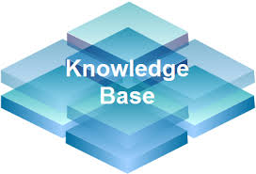
KNOWLEDGE BASE
Our approach will be to use a KB consisting
of two sorts of knowledge
  Unconditional knowledge (aka facts): atomic statements that are true
  Conditional knowledge: statements of the form
  If P₁ and … and P_{n} then Q, where P_{i} & Q are atomic
If, and, & then are special keywords
Other symbols are either
  variables (capitalized), or
  constants (uncapitalized)
  E.g., luke and r2d2 are constants, whereas
  Sith and Droid are variables
Your turn: variable or constant?
    Potato x THX1138 Variable hamster89 probFail

Slide 5
A SAMPLE KB
obi_wan is a jedi qui_gon is a jedi
yoda is a jedi mace_windu is a jedi
dooku is a sith sidious is a sith
luke was padawan to obi_wan obi_wan was padawan to qui_gon
qui_gon was padawan to dooku dooku was an apprentice to sidious
If A was padawan to B then B is a jedi
If A was padawan to B then A is a jedi

Slide 6
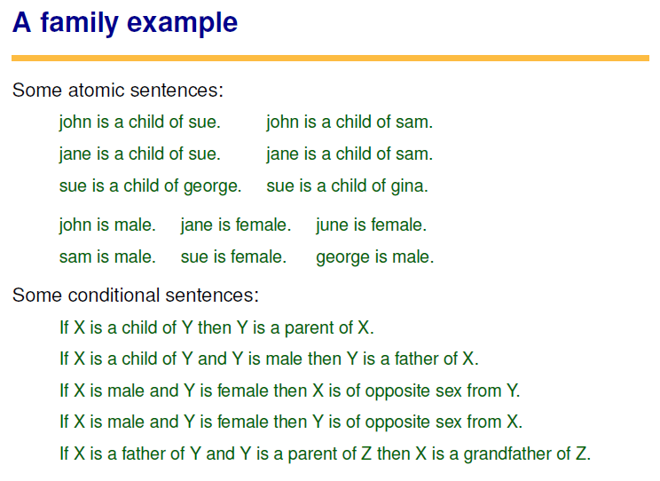

Slide 7
LOGICAL ENTAILMENT
X logically entails Y when the truth of X requires us to conclude that Y is also true.
For example, “The president was assassinated.” entails “The president is dead.” because assassination conceptually requires death.
In our approach, entailment is entirely syntactic, based on the structural relationships between atomic and conditional sentences
In other words, it doesn’t matter what the symbols mean, in fact attention to semantics can lead us astray.
The two statements “X” and “If X then Y” entail “Y”. Why?

Slide 8
ENTAILMENTS
yoda is a jedi
  Why is this entailed?
  It appears in the KB!
dooku is a jedi
  Is this entailed?
  The KB doesn’t say it explicitly…
obi_wan is a jedi
qui_gon is a jedi
yoda is a jedi
mace_windu is a jedi
dooku is a sith
sidious is a sith
luke was padawan to obi_wan
obi_wan was padawan to qui_gon
qui_gon was padawan to dooku
dooku was an apprentice to sidious
If A was padawan to B then B is a jedi
If A was padawan to B then A is a jedi

Slide 9
ENTAILMENTS
yoda is a jedi
  Why is this entailed?
  It appears in the KB!
dooku is a jedi
  Is this entailed?
  The KB doesn’t say it explicitly…
  But these two sentences entail it.
    How does this work?
obi_wan is a jedi
qui_gon is a jedi
yoda is a jedi
mace_windu is a jedi
dooku is a sith
sidious is a sith
luke was padawan to obi_wan
obi_wan was padawan to qui_gon
qui_gon was padawan to dooku
dooku was an apprentice to sidious
If A was padawan to B then B is a jedi
If A was padawan to B then A is a jedi

Slide 10
ENTAILMENTS
yoda is a jedi
  Why is this entailed?
  It appears in the KB!
dooku is a jedi
  Is this entailed?
  The KB doesn’t say it explicitly…
  But these two sentences entail it.
    How does this work?
    A = qui_gon
    B = dooku
obi_wan is a jedi
qui_gon is a jedi
yoda is a jedi
mace_windu is a jedi
dooku is a sith
sidious is a sith
luke was padawan to obi_wan
obi_wan was padawan to qui_gon
qui_gon was padawan to dooku
dooku was an apprentice to sidious
If A was padawan to B then B is a jedi
If A was padawan to B then A is a jedi

Slide 11
ENTAILMENTS
yoda is a jedi
  Why is this entailed?
  It appears in the KB!
dooku is a jedi
  Is this entailed?
  The KB doesn’t say it explicitly…
  But these two sentences entail it.
    How does this work?
    A = qui_gon
    B = dooku
    Then B is also a jedi, so dooku is a jedi
Even if you’ve never seen Star Wars…
obi_wan is a jedi
qui_gon is a jedi
yoda is a jedi
mace_windu is a jedi
dooku is a sith
sidious is a sith
luke was padawan to obi_wan
obi_wan was padawan to qui_gon
qui_gon was padawan to dooku
dooku was an apprentice to sidious
If A was padawan to B then B is a jedi
If A was padawan to B then A is a jedi

Slide 13
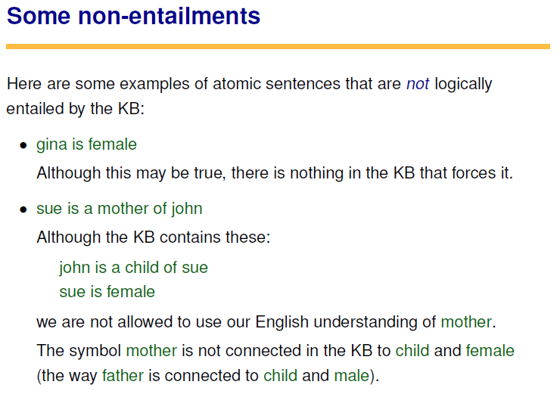

Slide 14
THOUGHT, VERSION 1.0
In this approach, thinking consists of determining whether statements are entailed by the knowledge base.
How could this be automated?
  By an algorithm!
  Back-chaining: a procedure to determine whether a given atomic statement, called a query, is entailed by a KB
  We will see that it is actually a bit more complicated than this – back-chaining is capable of more sophisticated behavior!

Slide 15
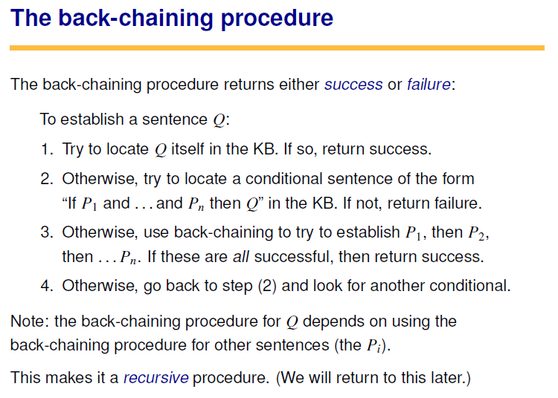

Slide 16
VARIABLES
george is a parent of sue

Slide 17
VARIABLES
george is a parent of sue
  We find a match in step 2:
    X = sue
    Y = george
  So in step 3, we need to
  remember this, so that what
  we need to establish is
    X is a child of Y, or

Slide 18
VARIABLES
george is a parent of sue
  We find a match in step 2:
    X = sue
    Y = george
  So in step 3, we need to
  remember this, so that what
  we need to establish is
    X is a child of Y, or
    sue is a child of george
  Fortunately, this can be found
  in the KB!!

Slide 19
PRACTICE
gina is female
george is a father of sue
jane is of opposite sex
from george
  We will try step 2 twice to succeed
george is a grandfather of john
  We’ll come back to this if
  there is time…

Slide 20
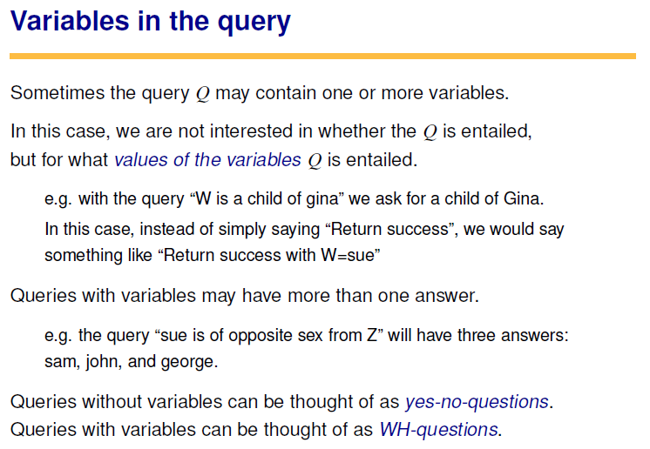

Slide 21
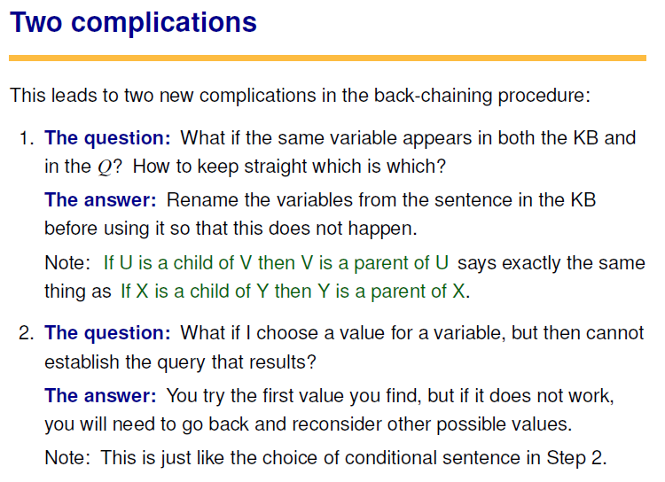

Slide 22
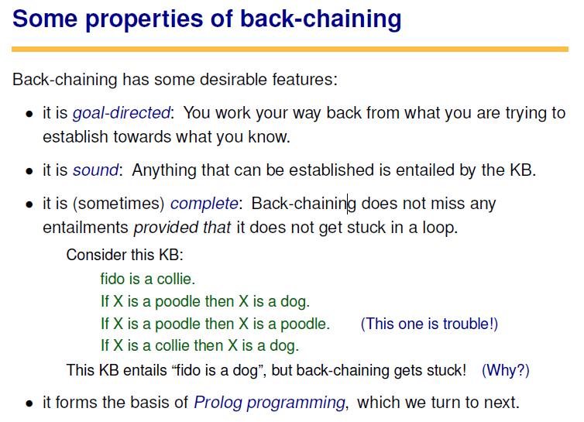

Slide 23
NEXT TIME…
Expert Systems
The Physical Symbol System Hypothesis

